Slide 1
Week 5. Robustness, Models, Environments
A. Michelle Lawing, PhD
Associate Professor
Paleobiology, Evolution, and Climate Lab
Ecology and Conservation Biology
Texas A&M University
alawing@tamu.edu

Slide 2
Welcome, hello, any announcements?

Slide 3
Project Milestones
Date | Milestone
Sept. 11 | Project topic
Oct. 2 | Data plan
Oct. 23 | Modeling plan
Nov. 6 | Preliminary results
Dec. 1 (optional) | Full final draft due
Dec. 1 (redefined day) Dec. 10 1-3 pm (finals slot) | Presentation
Dec. 11 | Final paper

Slide 4
Class Plan
Review Lab 03
  Check and update interpretations (commit)
  Check and update repeatability (commit)
  Push
Preview presence-background models
Overview of questions these models can address
Read Peterson Chapter 6 for Thursday class preparation

Slide 5
Lab 03 Debrief
Distinguish background, absence, and suitable habitat
Interpret M as an accessibility hypothesis
Evaluate whether an ecological interpretation is stable given a change in M
Make the analysis reproducible before fitting a model

Slide 6
Class progress
Everyone connected occurrences to environmental variables
Everyone produced an environmental-space comparison
Most students correctly recognized that background points are not confirmed absences
The main difficulty was explaining what “stable” or “conditional” means

Slide 7
Background, absence, and suitability
A background point represents a sampled environmental condition available within the assumed M
A background point does not establish:
  Species absence
  Habitat suitability
  Survey effort
  Failure to detect the species
A location represented by a background point may contain the species, lack the species, or be inaccessible for reasons outside the selected predictors

Slide 8
M as an accessibility hypothesis
M represents the area the species could have accessed during the relevant period
A distance buffer is a simplified hypothesis about M. It is not:
  An individual home range
  A maximum movement distance
  Suitable habitat
  The true species range
A defensible M may require information about dispersal history, barriers, elevation, connectivity, or biogeographic regions

Slide 9
Robustness of interpretations
Stable: substantively unchanged across plausible scenarios
Conditional: valid only under specified assumptions
Not robust/unstable: disappears or reverses under plausible alternatives

Slide 10
Robustness refers to an interpretation
Sample | Average mean annual temperature
Occurrences | 13.82°C
50-km background | 18.13°C
200-km background | 19.33°C
Interpretation: Occurrences represent cooler environments than the sampled background under both M assumptions.
Direction: stable
Magnitude: conditional on M
We evaluate the robustness of the ecological conclusion, not whether one buffer or figure looks more stable

Slide 11
Common interpretation errors
“Background points are suitable but unoccupied habitat.”
  Background describes availability, not confirmed suitability or occupancy.
“The 150-km M is more stable.”
Stable describes an interpretation across assumptions, not an M value.
“The broader M produced more background points.”
Both scenarios sampled 1,000 points. The environmental range changed.
“White space inside the buffer means unsuitable habitat.”
White cells usually contain no raster value, often because the buffer extends over water.

Slide 12
Repair the interpretation
Choose one environmental variable:
  Compare occurrences with background under each M.
  Write(rewrite) one ecological interpretation/conclusion.
  Classify the interpretation/conclusion as stable, conditional, or unstable.
  Cite numbers or a visible pattern as evidence.
  Save your updated script and ReadMe
  Commit your changes (wait to push)

Slide 13
Reproducibility check
Restart R and run the script from the project root
Remove any hard-coded commands
Confirm that the script recreates both figures and saves them to the output folder
Confirm that all of your choices in the script match the README and figure labels
Check the order of your scripting output and that functions are defined before they are called
Save your updated script
Commit your changes and push

Slide 15
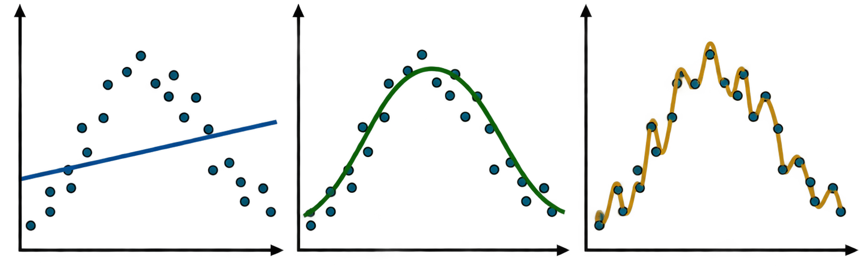
Presence-Background Models
These models compare environmental conditions at occurrence locations with conditions available within M. They differ mainly in their structure and complexity.
Model type | Example | Typical use
Maximum entropy | Maxent, maxnet | Estimate relative suitability from occurrences and background environments
Point-process model | Poisson point-process model | Model the relative intensity of occurrence locations across space
Resource-selection model | Resource selection function, or RSF | Compare locations used by organisms with available locations
Regression | Logistic regression, GAM | Estimate environmental associations using occurrences coded 1 and background coded 0
Tree-based model | Boosted regression trees | Fit nonlinear relationships and interactions
Machine learning | Random forest | Classify occurrences relative to sampled background
Ecological-factor analysis | ENFA | Compare the environments used by a species with the environments available
Ensemble model | biomod2 ensemble | Combine predictions from several presence-background algorithms

Slide 16
Questions that presence-background models can answer

Slide 17
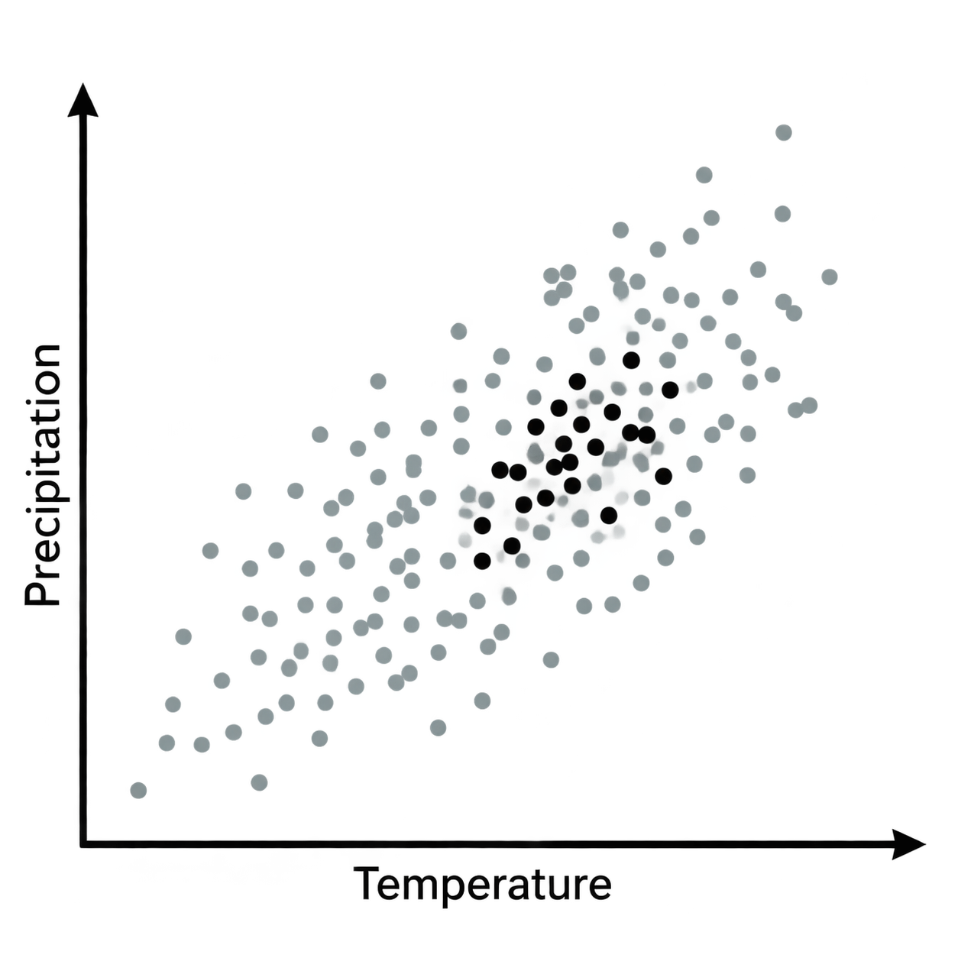
Within the environments a species could access, where are occurrences concentrated more than expected from availability?
A salamander may occur mainly in cool, moist ravines even though warmer slopes were also accessible. This suggests an environmental association with cool, moist places.
It matters because:
It tests whether the predictors contain an ecological signal
It describes environmental selection relative to what was available
It avoids treating background locations as confirmed absences
Important limitation: The pattern shows association, not physiological causation
Occurrence points black
Background points gray

Slide 18
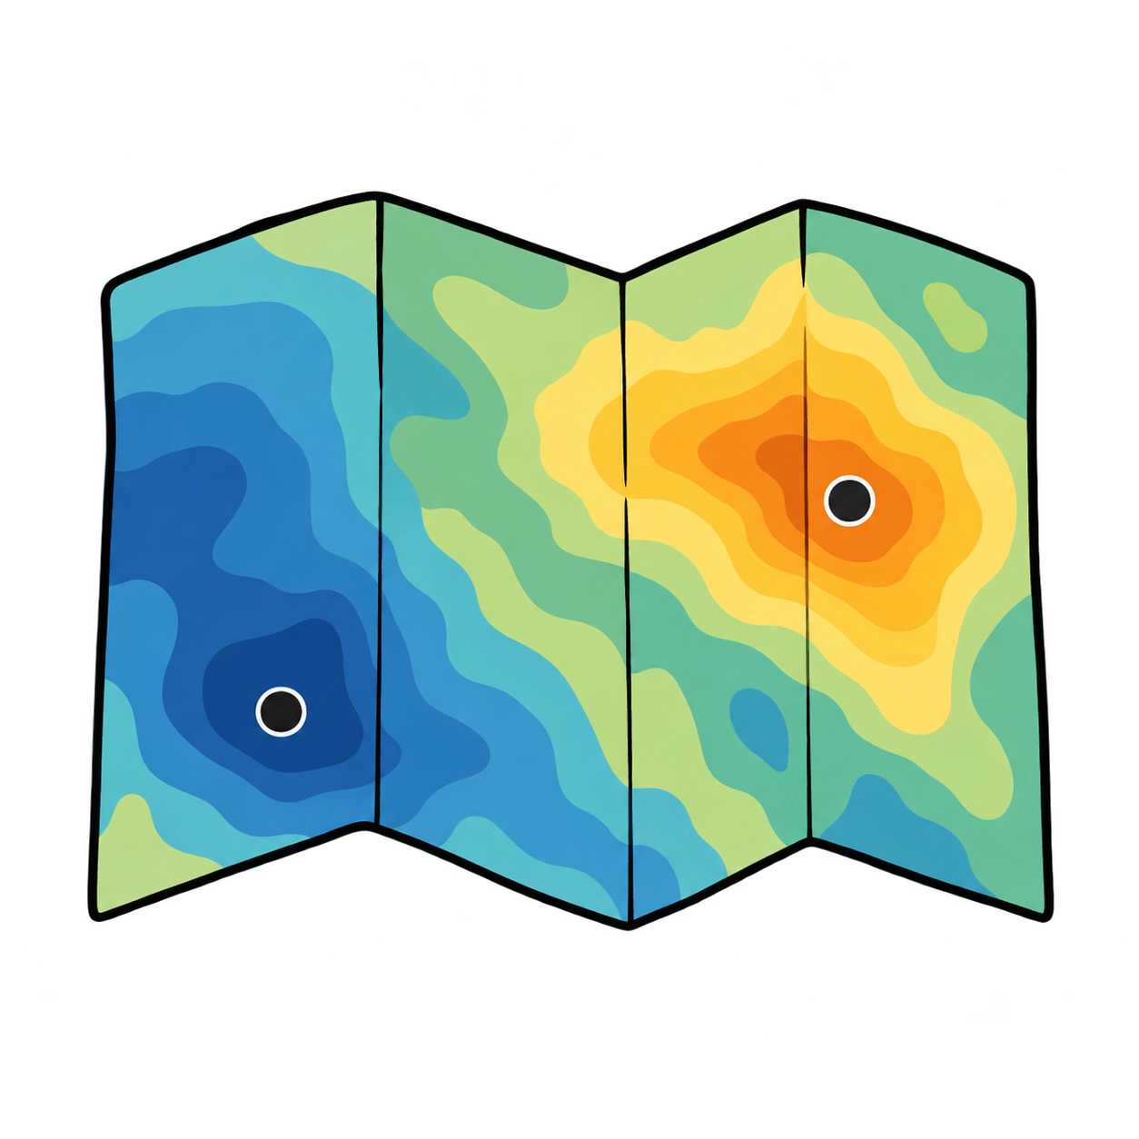
Where is relative environmental suitability higher or lower within the modeled region?
This type of question is useful for ranking survey, conservation, or restoration areas.

Slide 19
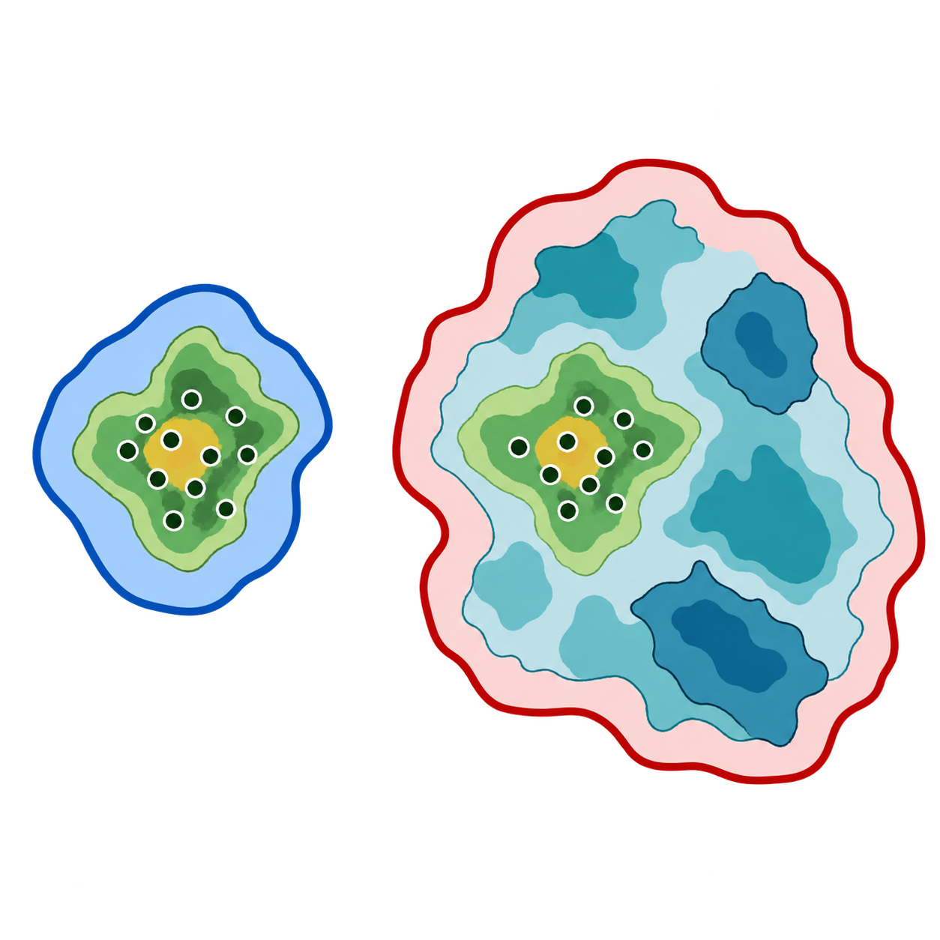
How does the predicted suitability pattern change under alternative definitions of M?
This type of question tests whether conclusions depend on assumptions about dispersal history and accessibility.

Slide 20

Which unsampled areas have environments similar to known occurrence locations?
This type of question helps answer where else we should survey.
Example: finding unsurveyed limestone areas similar to locations occupied by a rare plant.

Slide 21
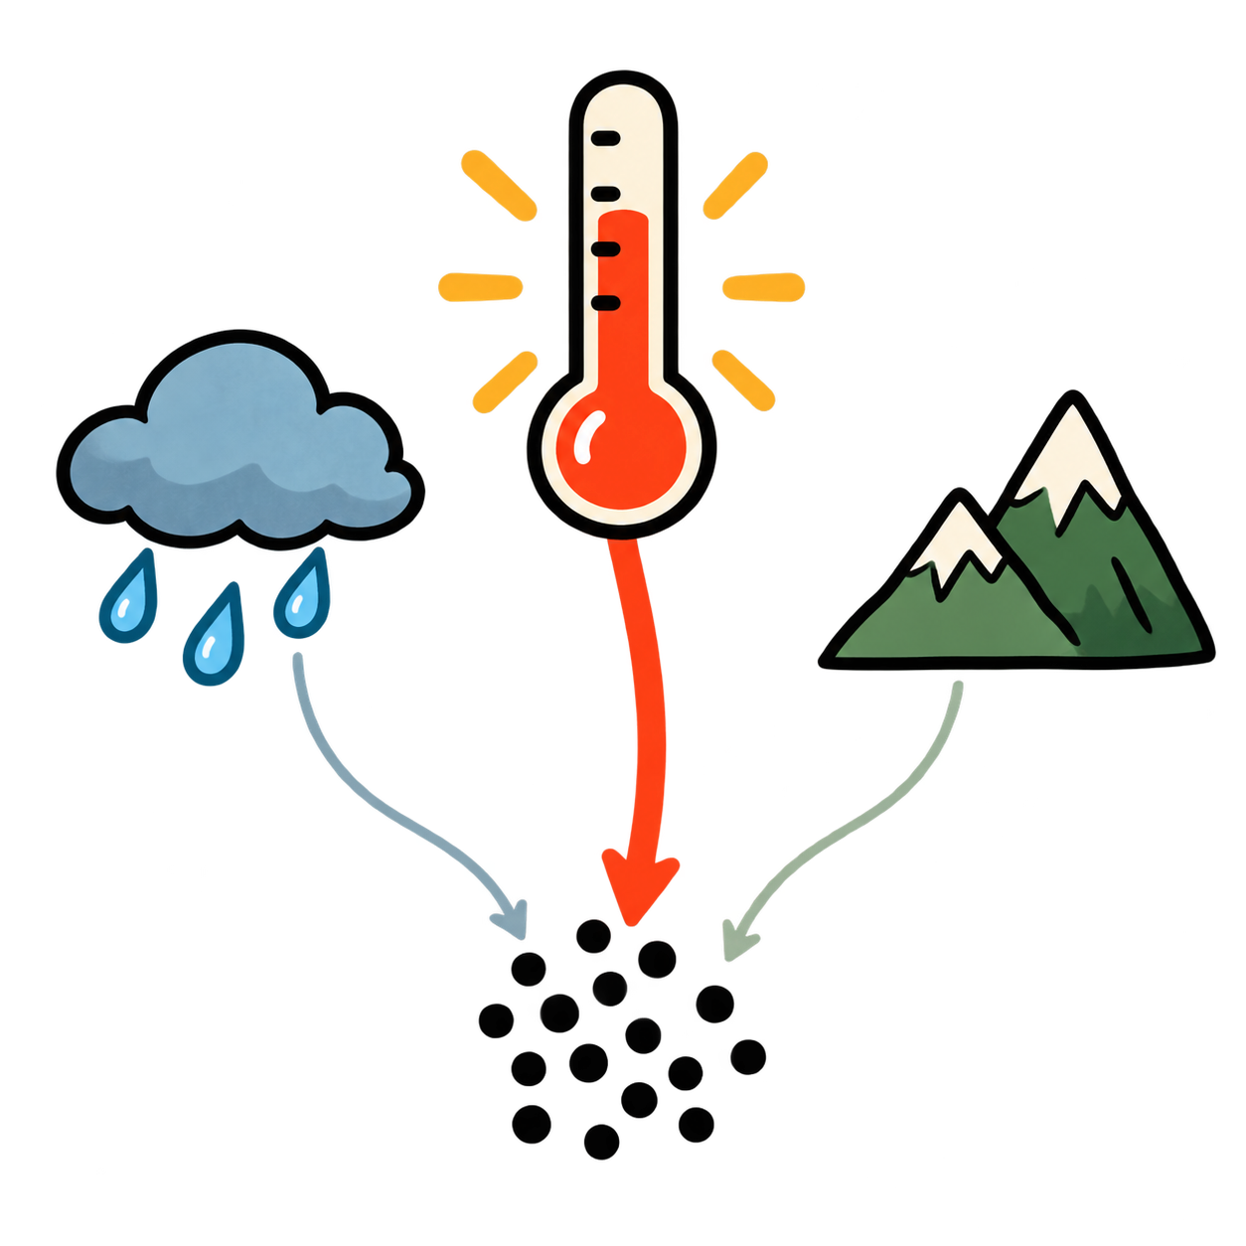
Which predictors have the strongest associations with occurrence locations?
This type of question helps prioritize ecological hypotheses, but importance does not prove show causation.

Slide 22
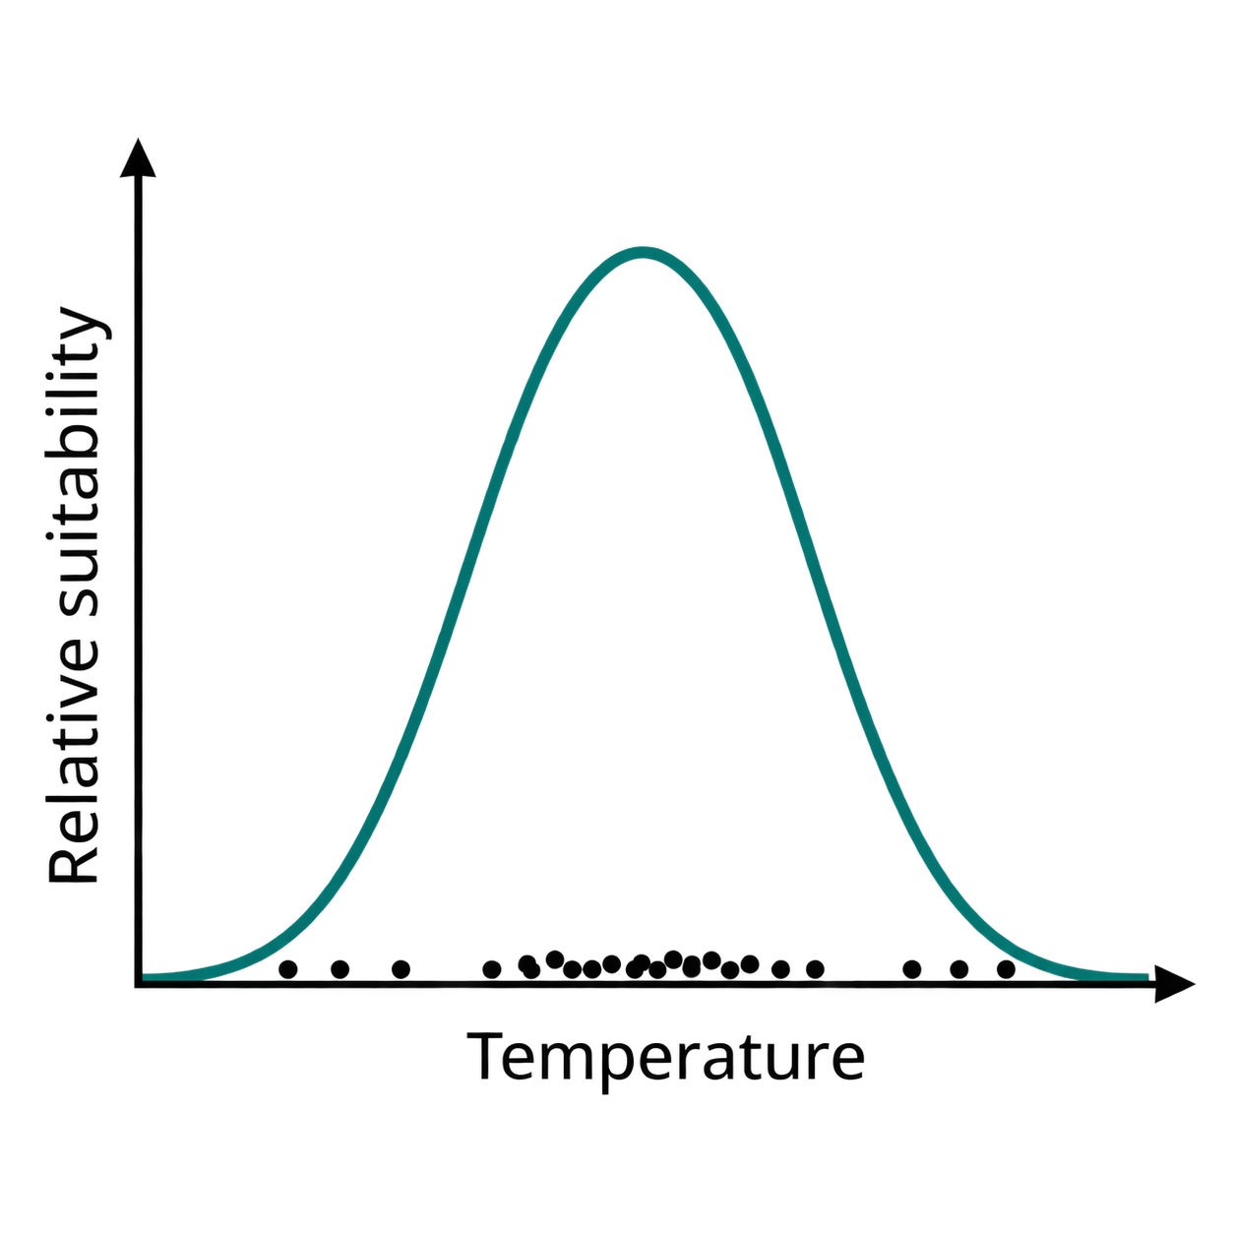
What is the shape of the association with temperature, precipitation, elevation, or other predictors?
This type of question can reveal an optimum, threshold, or limiting condition.

Slide 23
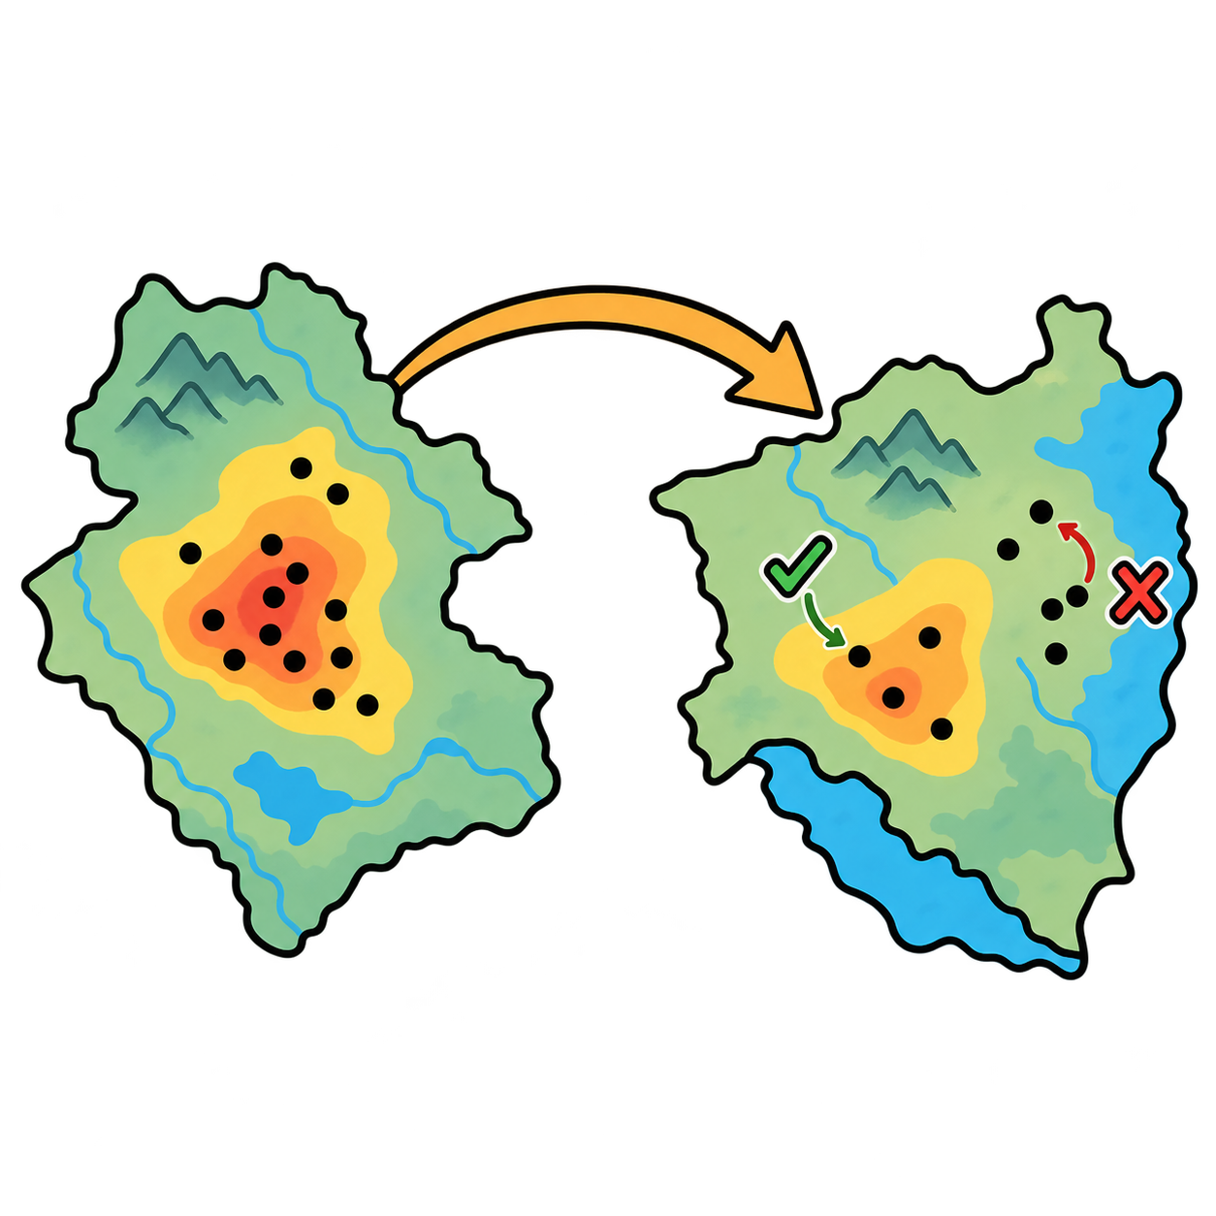
Does a model calibrated in one region or period transfer well to another?
This type of question is relevant when transferring from native to invaded ranges or from one region to another or from one time period to another.

Slide 24
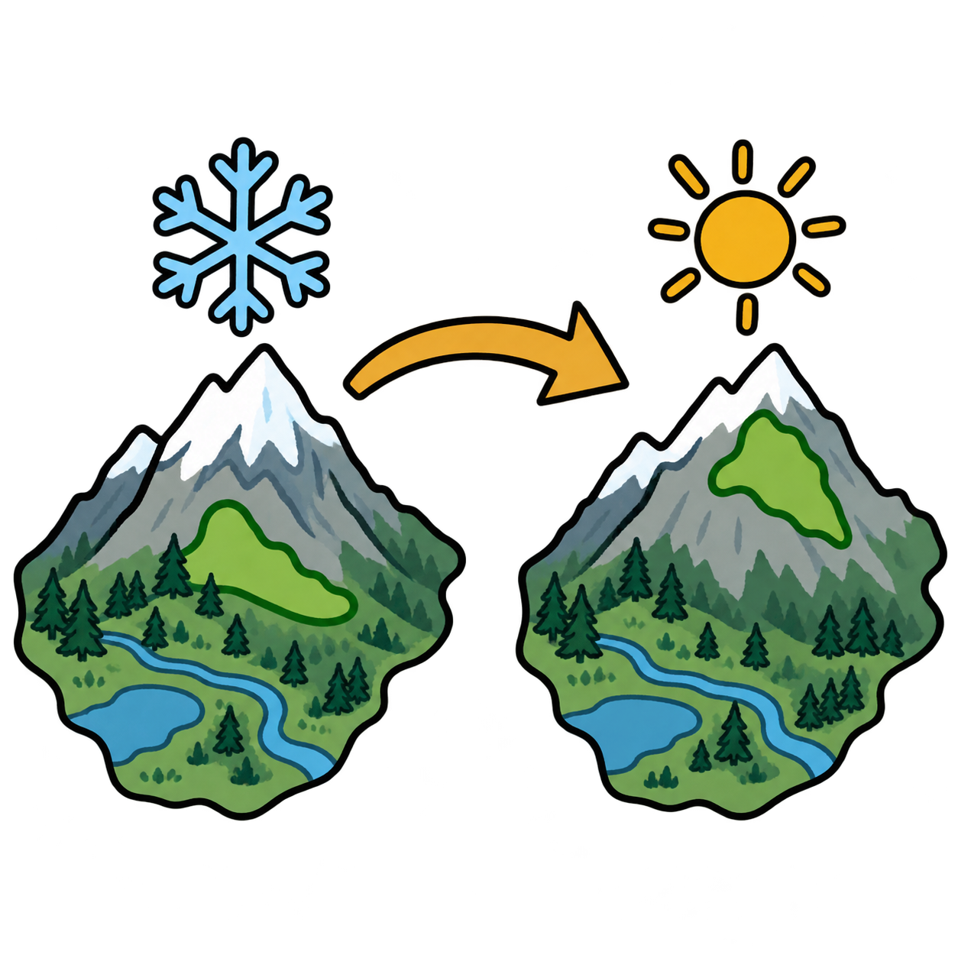
How might relative suitability shift under a future or past climate scenario?
This type of question is useful for identifying potential refugia or climate exposure, but not future occupancy.

Slide 25
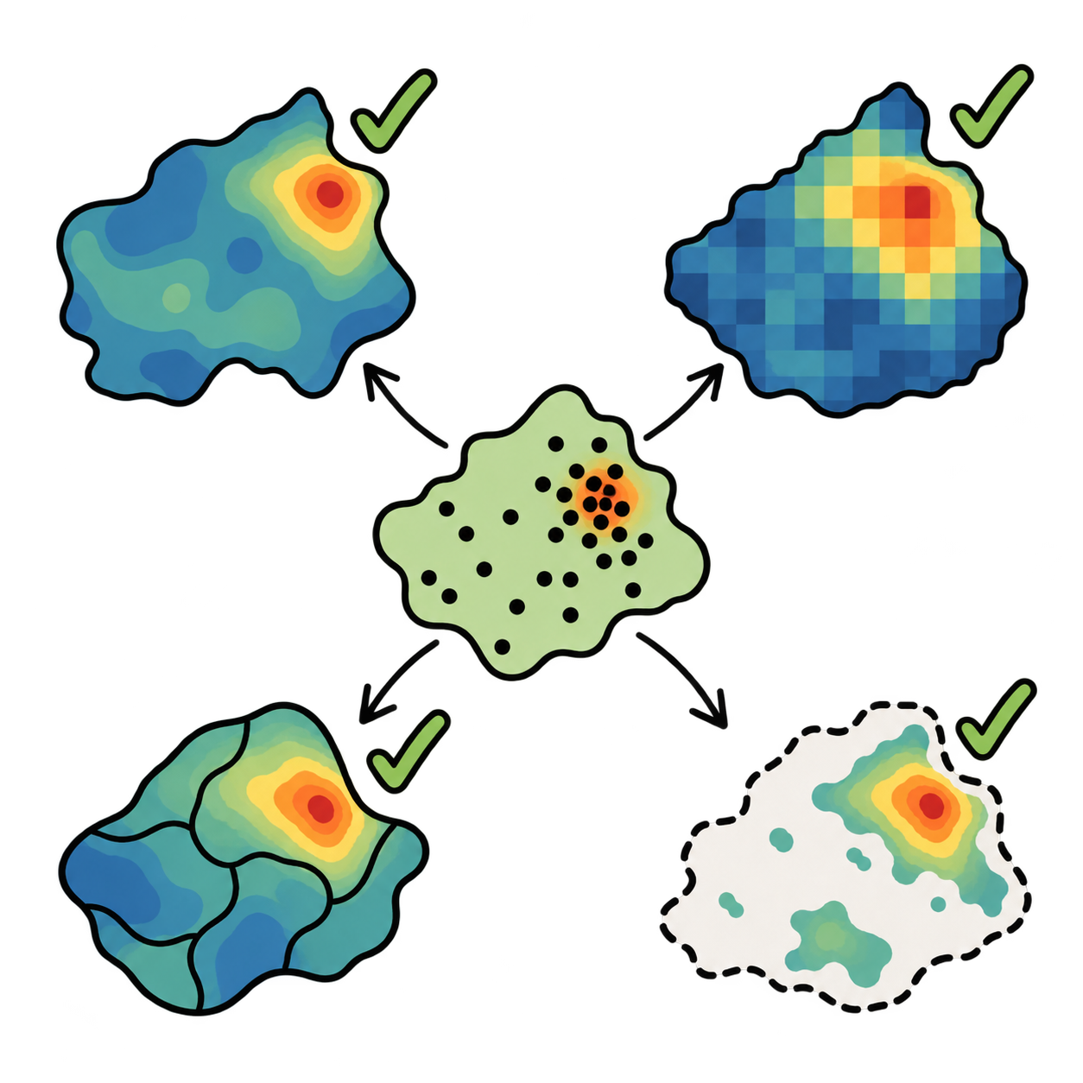
Are conclusions consistent across algorithms, predictor sets, background samples, or occurrence-filtering decisions?
This type of question makes any interpretation/conclusion stronger when it persists across M, predictors, and algorithms.

Slide 26
Connection to model fitting
A presence-background model compares:
  Environments at occurrences
  Environments sampled from the calibration region
The model estimates relative environmental suitability or discrimination within the specified sampling design. Keep in mind it does not estimate:
  Occupancy probability
  Detection probability
  Abundance
  Causal effects of environmental variables
Changing M changes the comparison used to fit the model. Later, we can fit the same model under several M assumptions and compare the interpretations.

Slide 27
Peterson et al. Chapter 6

Slide 28
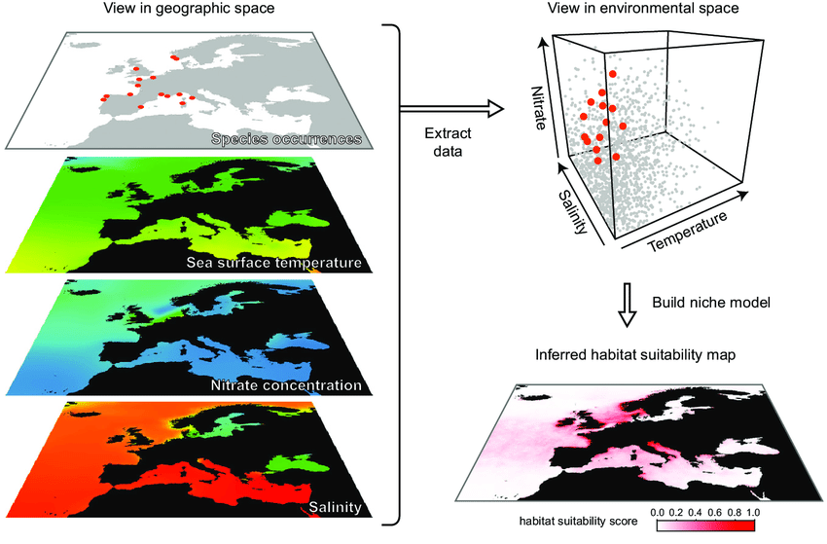
Environmental Data
Environmental predictors define the dimensions of environmental space
Predictor choice determines what the model can fit/learn and how its output can be interpreted
Marcelino, V.R. and Verbruggen, H. (2015), Ecological niche models of invasive seaweeds. J. Phycol., 51: 606-620.

Slide 29
The two main inputs to niche models
Species occurrence locations
Environmental raster layers
The model compares environments associated with occurrences to environments available within the study region
Marcelino, V.R. and Verbruggen, H. (2015), Ecological niche models of invasive seaweeds. J. Phycol., 51: 606-620.

Slide 30
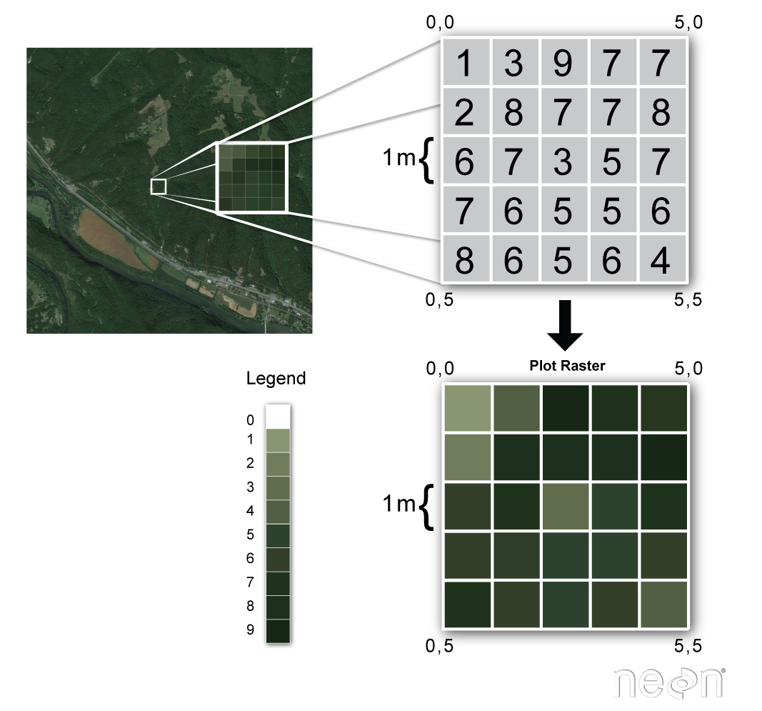
Environmental raster layers

Slide 31
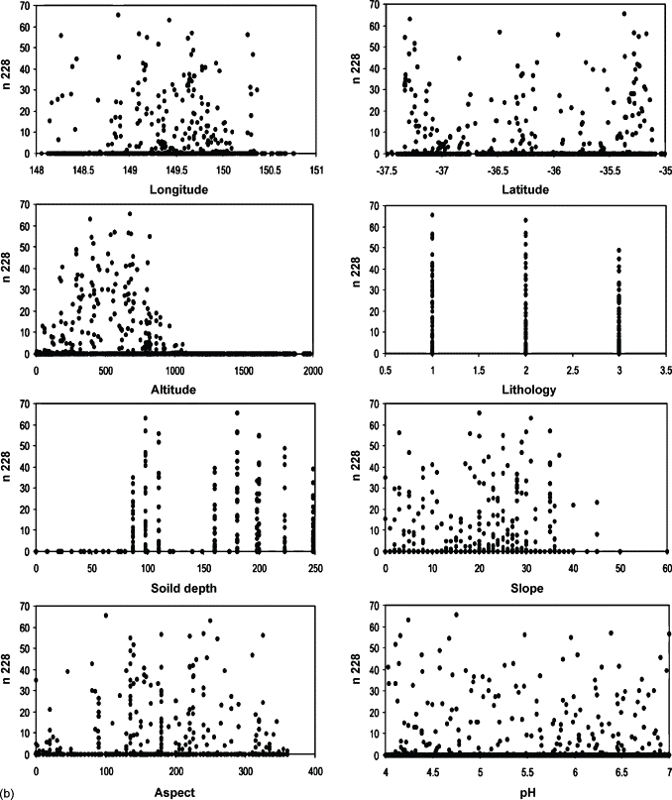
Species–environment relationships
Species respond to different combinations of environmental conditions
Relevant predictors differ among species and geographic contexts
A statistical association does not necessarily identify a causal mechanism
Figure 6.1. Example summary of responses of a virtual species to eight environmental characteristics. Adapted from Austin et al. (2006).

Slide 32
Types of environmental predictors
Indirect: correlated with causal conditions, such as elevation
Direct: affects organisms physiologically, such as temperature
Resource: consumed or modified by organisms, such as food or light

Slide 33
Causal distance
Proximal variables describe conditions that act directly on the organism
Distal variables summarize conditions through several causal steps
Example: freeze duration is proximal, mean annual temperature is distal
These categories can overlap with direct, indirect, and resource variables
annual temperature → freezing duration → survival

Slide 34
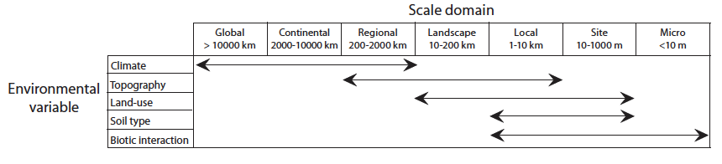
Environmental predictors operate at different scales (extents)
Broad extent: climate
Regional and landscape extent: topography, land cover, and vegetation
Local extent: microclimate, soil, resources, and biotic interactions
Predictor resolution should match the ecological process being studied

Slide 35
Predictor choice as an ecological hypothesis
Ask:
What aspect of the distribution am I trying to explain?
Am I estimating potential or occupied distribution?
Over what geographic and temporal scale?
Why should each predictor matter to this species?

Slide 36
How many predictors?
Too few predictors may omit important niche dimensions and produce overly broad predictions (under characterization)
Too many predictors may produce complex, overfit, and unstable models (over specified)
The risk increases when the number of occurrences is small
There is no universally correct number of predictors

Slide 37
Correlated predictors and dimensionality
Correlated variables contain overlapping information
Correlation can make response curves and variable importance difficult to interpret
Common approaches include ecological preselection, correlation filtering, and PCA
An algorithm may tolerate correlation while the ecological interpretation is unstable or unreliable

Slide 38
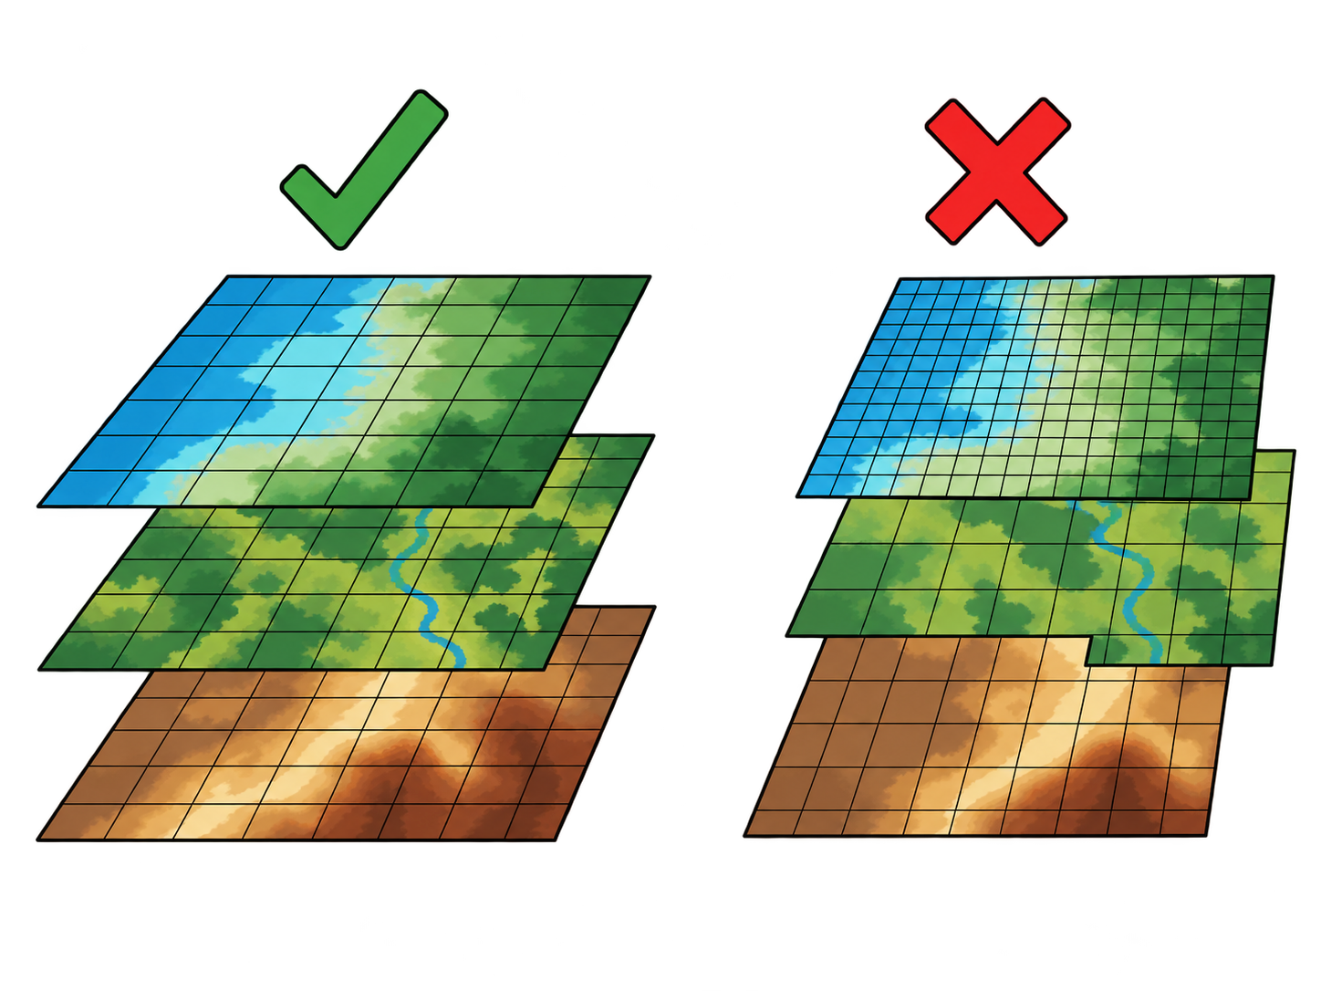
Building a raster stack
All predictor layers should have compatible:
Coordinate reference system and datum
Spatial extent and cell alignment
Resolution and origin
Units, variable definitions, and missing-value conventions

Slide 39
Data quality and metadata
Before modeling, examine:
The original data source and collection method
Interpolation or processing used to create the raster
Temporal coverage and station density
Known errors, uncertainty, and missing data
High spatial resolution does not necessarily mean high accuracy!

Slide 40
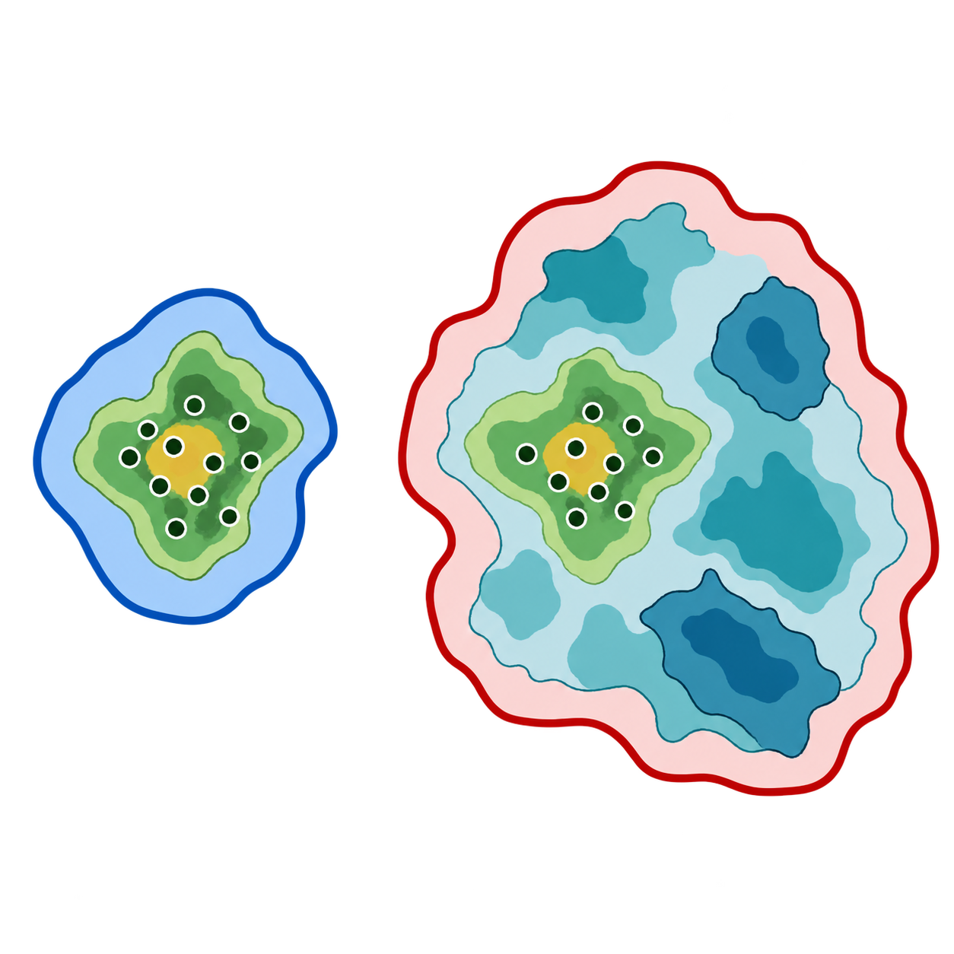
Spatial extent and M
The study extent determines which environments are available to the model
A very broad extent may include places the species could never access
These additional environments can change fitted relationships and model evaluation
The modeling extent should represent a defensible hypothesis about M

Slide 41

Spatial resolution
Grain size should match the organism, ecological process, and coordinate uncertainty
Upscaling loses fine-scale information (such as merging nearby occurrences and environmental details)
Downscaling often creates false precision without adding new information
Figure 6.3. Illustration of different spatial resolutions in geospatial datasets. MODIS satellite data from the region of the northern tip of Australia summarizing photosynthetic mass at 250 m resolution in gray scale, on top of WorldClim climatic data at 17 km resolution in the background, in black. Note that even the definition of islands as separate depends on the pixel resolution.

